Slide 1

PATRONES DE DISEÑO
Michael Vargas
2022

Slide 2
Agenda
Patrones
Layers
Repository
Unit of work
Repository + Unit of work
DDD
CQRS
25/03/2022

Slide 3

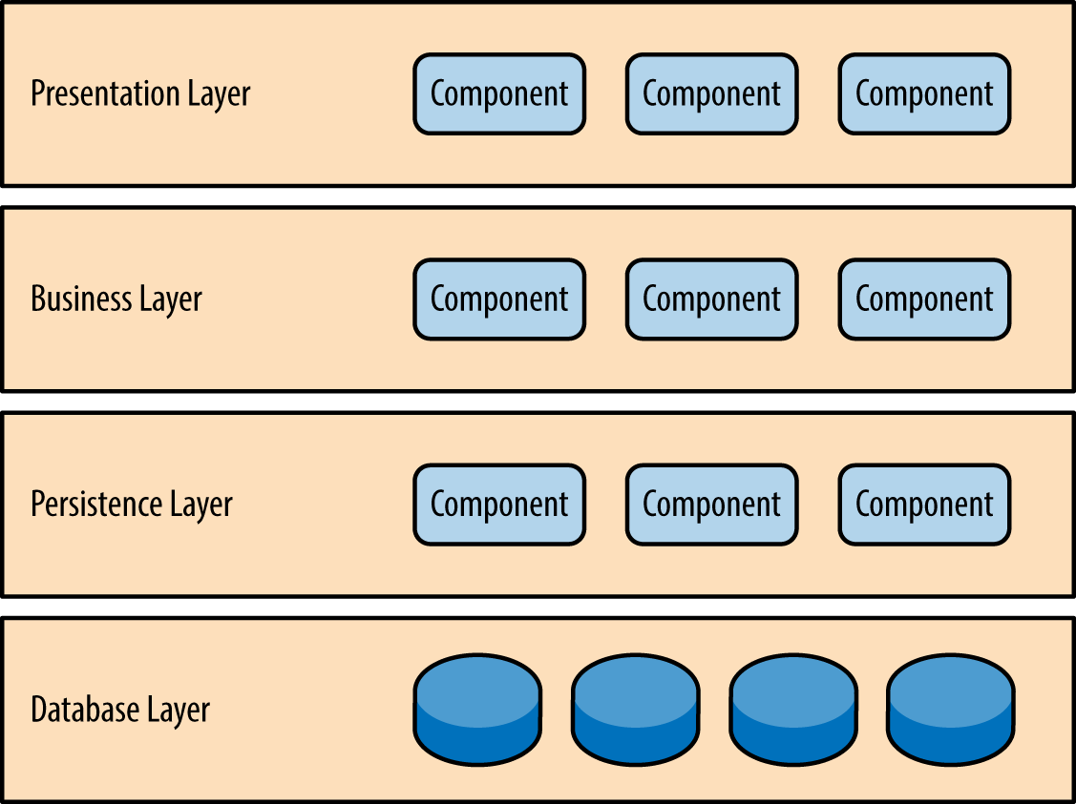
Patrones
Layers
https://www.oreilly.com/library/view/software-architecture-patterns/9781491971437/ch01.html

Slide 4
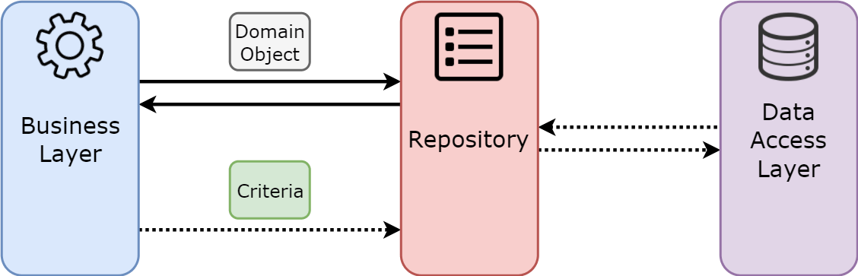
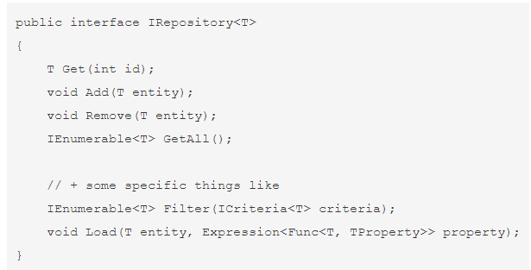
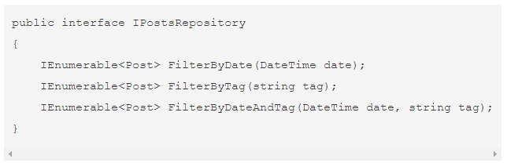
Patrones
Repository
A menudo se usa en dos enfoques:
Repositorio genérico con el intento de olvidar el ORM (Object Relational Mapping)
Repositorio como un conjunto de consultas a una tabla de la base de datos
1
1
2
2
https://codingsight.com/entity-framework-antipattern-repository/

Slide 5
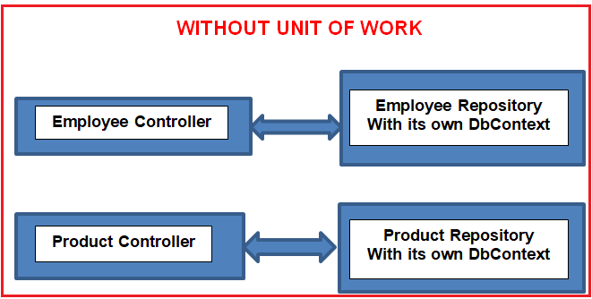
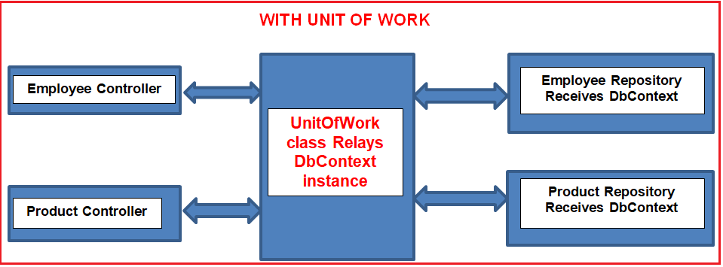
Patrones
Unit of work
Centraliza las operaciones de trabajo en un único componente
https://www.oreilly.com/library/view/software-architecture-patterns/9781491971437/ch01.html

Slide 6
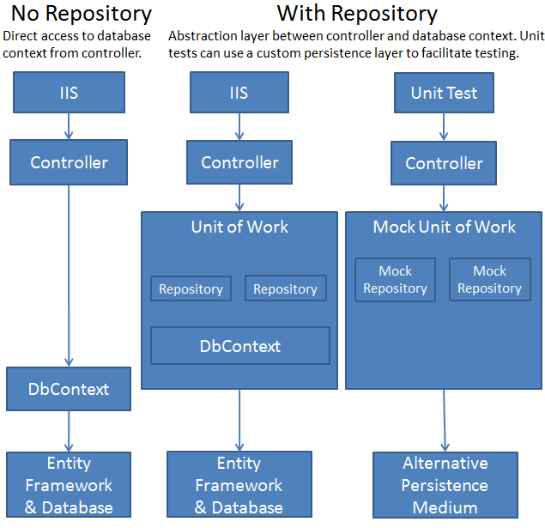
Patrones
Repository + Unit Of Work
https://docs.microsoft.com/en-us/dotnet/architecture/microservices/microservice-ddd-cqrs-patterns/infrastructure-persistence-layer-design#:~:text=of%20Work%20patterns.-,The%20Repository%20pattern,from%20the%20domain%20model%20layer.

Slide 7
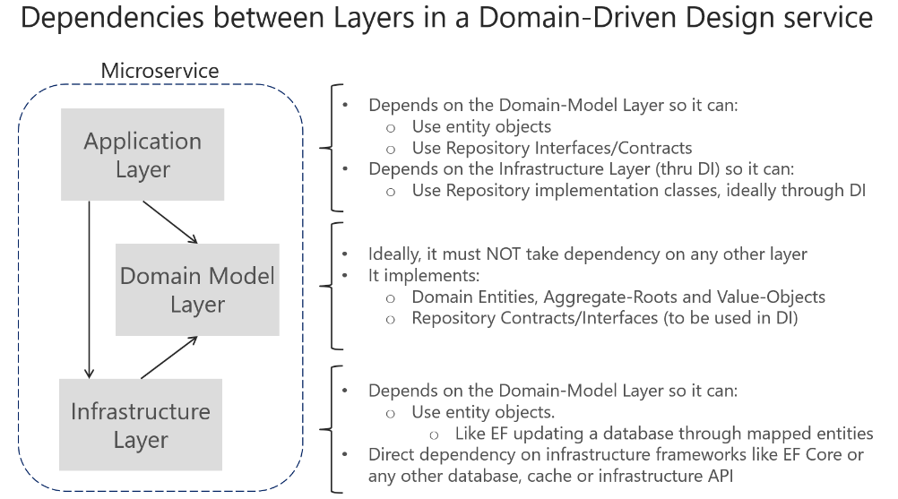
Patrones
DDD
Domain Driven Desing
https://docs.microsoft.com/en-us/dotnet/architecture/microservices/microservice-ddd-cqrs-patterns/ddd-oriented-microservice

Slide 8
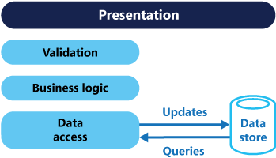
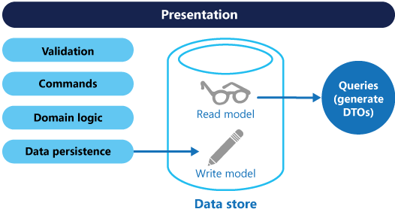
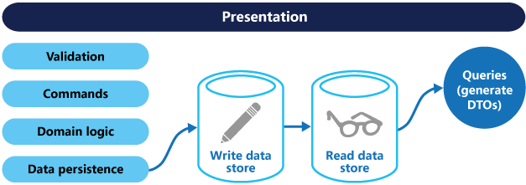
Patrones
CQRS
Command and Query Responsibility Segregation
Problema:
Solución:
https://docs.microsoft.com/en-us/dotnet/core/extensions/dependency-injection

